Slide 1
Communication with media: tips for team medical staff
ICL # 31
May 16 2013, Toronto ISAKOS
John Orchard

Slide 2
Structure of pro sport organisation
CEO
Sporting Dept head
Head Coach
Medical Staff
Media, Finance & Commercial head
Media/website managers

Slide 3
Role of medical staff in media
Traditionally the medical staff (incl team doctors) report indirectly to the head coach of the team
More modern management structure is for medical staff to report to managerial head of the sporting (e.g. football) department who is independent of head coach
This distinction is important for procedural issues (including public reporting of injuries)
It is also traditional for coaches to be highly secretive about player injury information (to avoid disclosure to opposition teams). However this leaves a conflicting position with media/commercial (who want to disclose information to the fan base) & with general admin (who need to avoid any competition / regulatory fines for non-disclosure, if competition has rules that require disclosure to avoid gamblers unfairly obtaining inside information)
Therefore a team doctor needs to know the team’s organisation structure

Slide 4
“Don’t speak to media” rule
Traditionally team doctors have avoided engaging with the media for fear of (1) being misquoted or (2) upsetting the coaching staff +/- players by disclosing information
However a blanket ban on media comment is now outdated, as there is expectation for comment in certain situations and it is much easier to comment without being misquoted using new media/planned releases
Basically if a star player has visibly sustained a major injury, it is not only churlish but also counter-productive for a pro team to not comment on this player’s injury status, including quotation(s) from the medical staff
It is good for a pro team to have a reputation (internally & externally) for having top quality medical staff, but this reputation must be earned
The team’s media manager can and should instruct the medical staff about whether this comment should be prepared (media release only with no questions taken) or open (doctor allowed to speak directly to journalists)

Slide 5
Are journalists all reptiles?
Journalists need stories like fish need water, and stories must be interesting to be worthy of publication. Put yourself in the shoes of the journalist.
However for some situations the facts sell themselves. For example, if you are passing on information that your star player has suffered an ACL rupture and is seeking opinions from 2 esteemed orthopedic knee surgeons, then this is interesting enough news to be a good story without any abuse of your words.
If you are asked questions in the manner of a fishing expedition (e.g. do you think there are many players in the league that are using undetectable performance enhancing drugs?) then this sort of Q is a RED FLAG. If you answer it cleanly, it is too boring to actually appear as a quotation in a story, but if you give a controversial answer, your words could be spliced and twisted creating a headline that you didn’t intend.
Answer questions on a topic that you NEED to provide information on (e.g. what your star player just injured) not on random topics where a journo is fishing

Slide 6
Twitter: you don’t get (mis)quoted
Twitter is ideal new media for comment on a topic that you want/NEED to make a statement on.
You only get 140 characters so your statement is already a “bite” than a journalist can’t cut & trim any further than what you have already done.
ALL of your statements are public property, so don’t criticise match officials, coaching staff or other medical professionals on Twitter.
You can impress players, team fans & everyone with responsible discussion of medical issues

Slide 7
You only answer Qs you wish
Discussion/retweeting on topics such as responsible management of concussion is good practice, but be very careful to avoid (publicly) criticising other medical teams for their management.

Slide 8
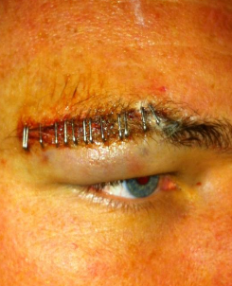
(vast majority) of athletes use it

Slide 9
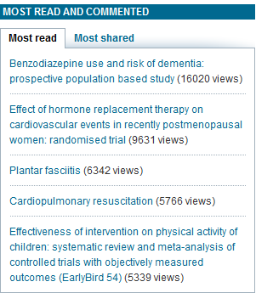
Free publicity if you use it well
Basically social media is now an essential tool for dissemination of medical research amongst lay people & other professionals

Slide 10
Conclusions
All pro sports teams NEED a media policy for comment on injury/medical matters. Be a friend not a foe with your media manager
You will rapidly become a dinosaur if you maintain a zero contact policy with traditional media and social media
However there are definite traps/red flags on medical & injury issues and you need to know how to tiptoe around the land mines
Team doctor work is not just about clinical competency!

